Slide 1
Gaming Handheld
Ethan Quigley
12/19/2025

Slide 2
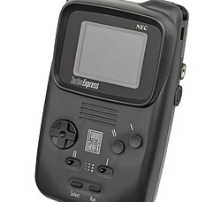
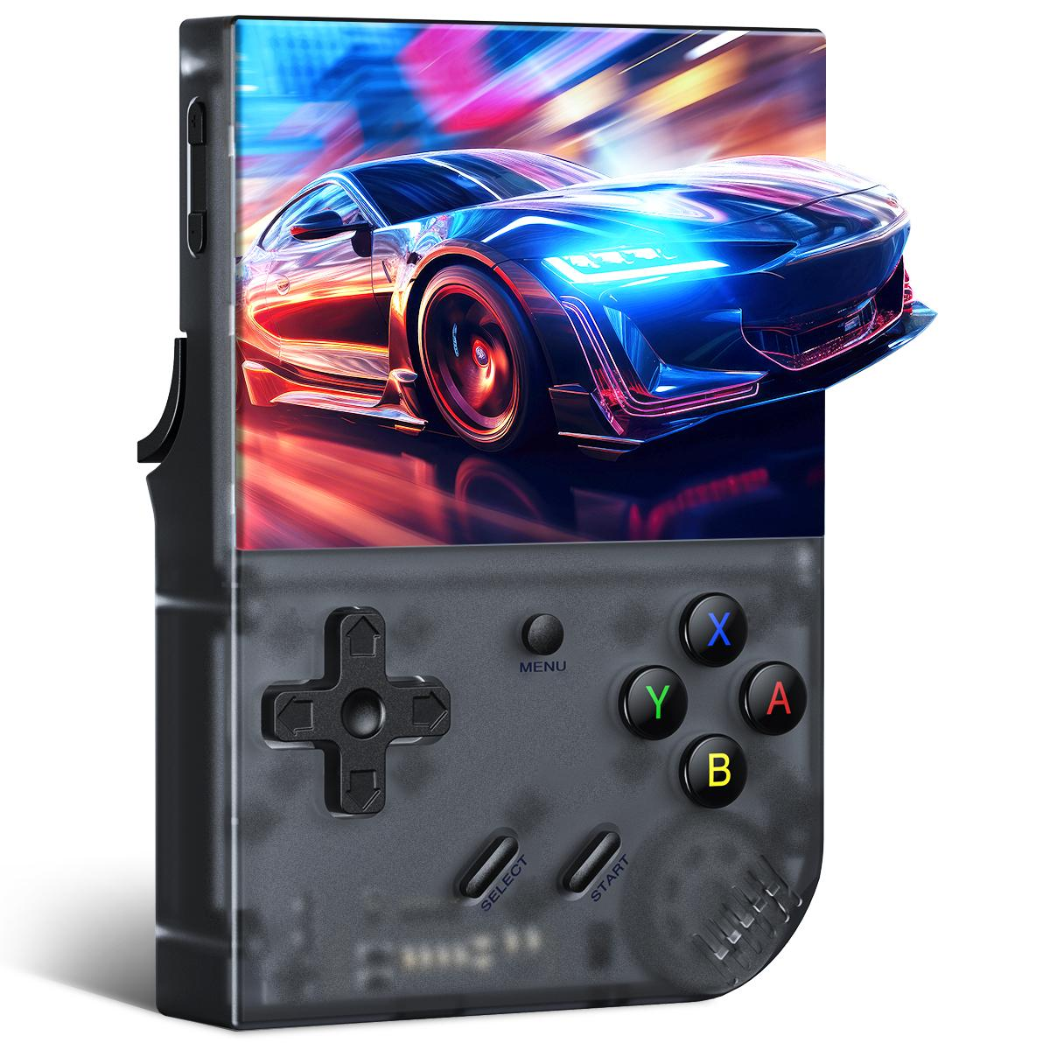
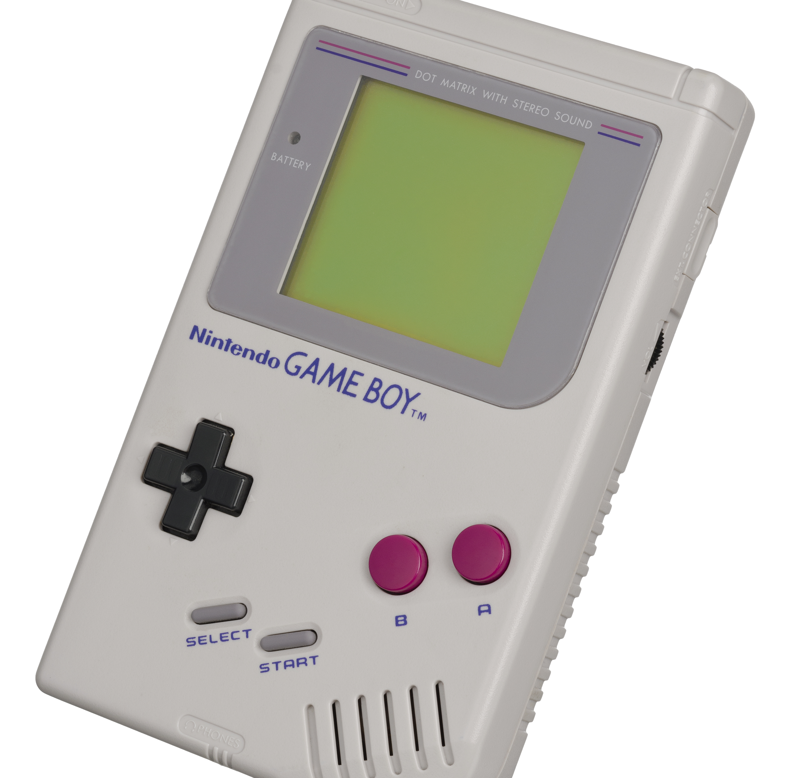
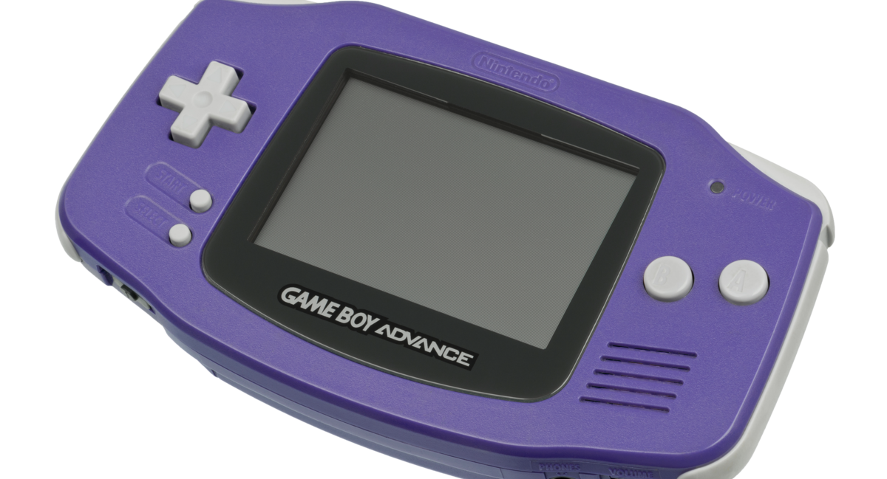
Inspiration

Slide 3
Inspiration

Slide 4
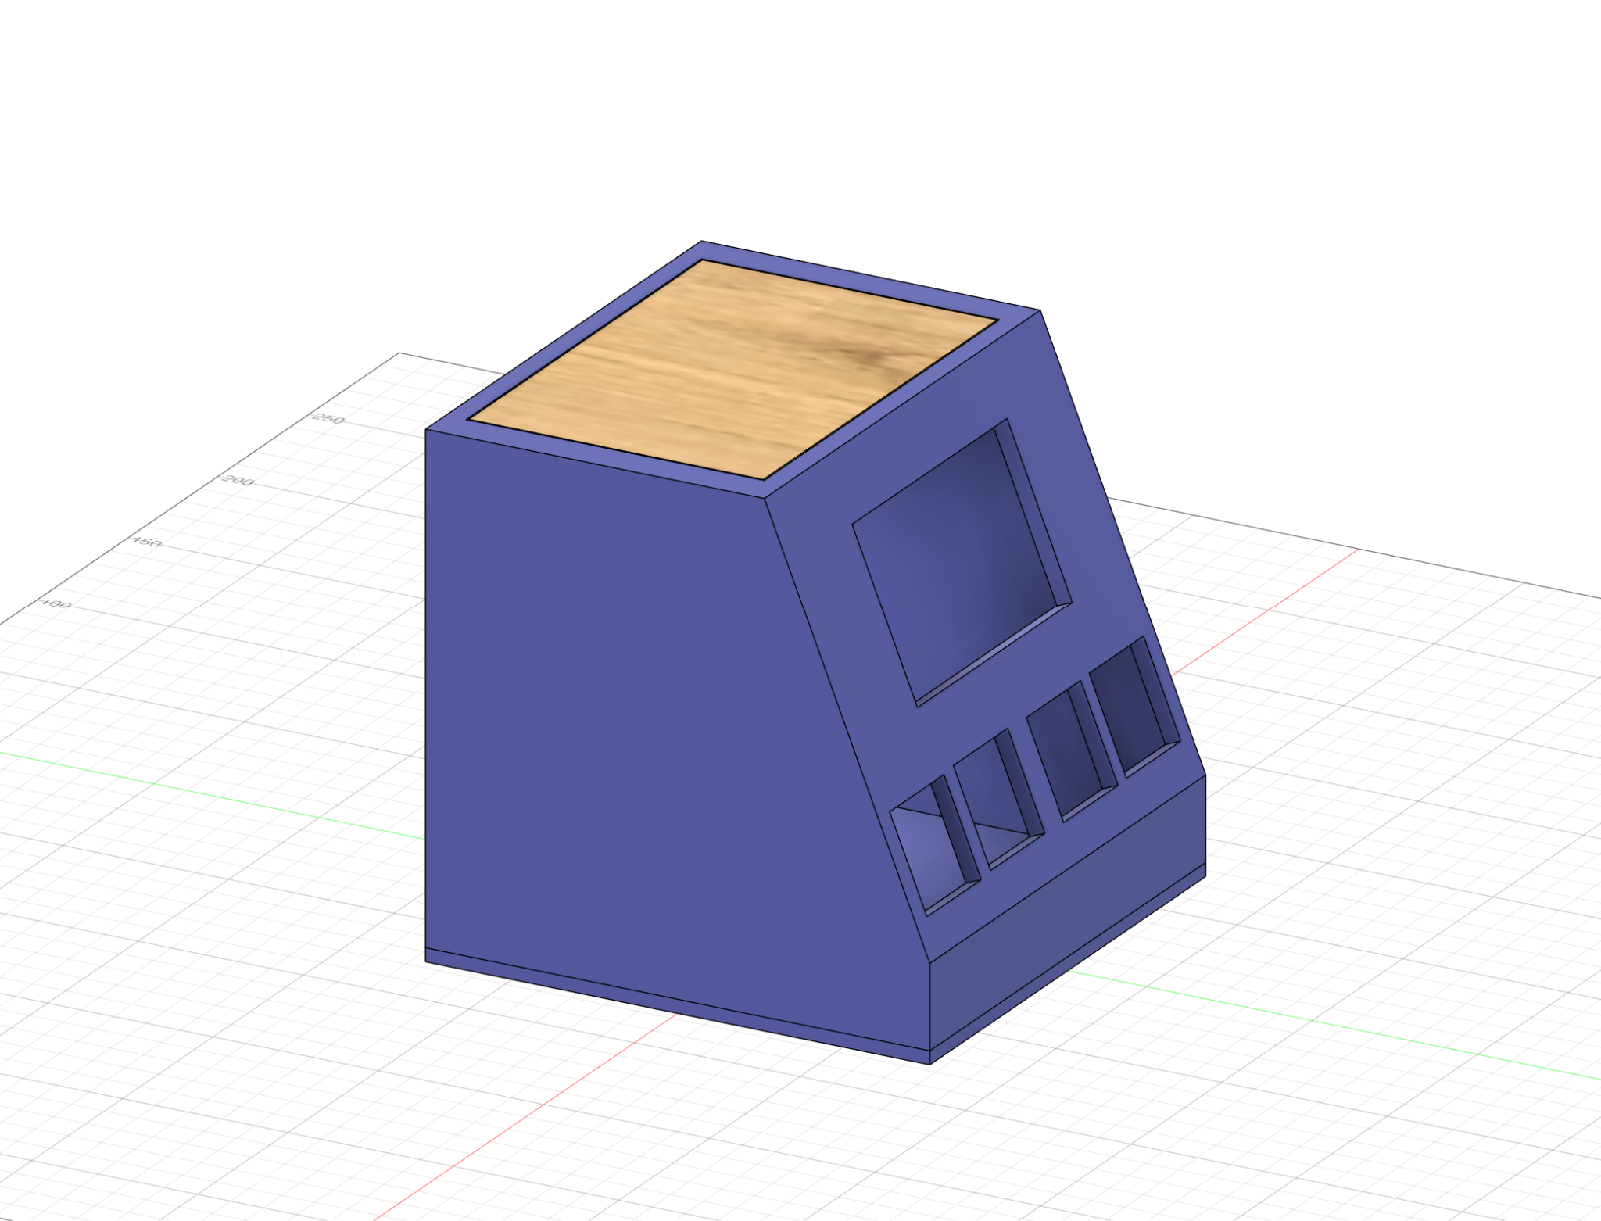
Inspiration

Slide 5
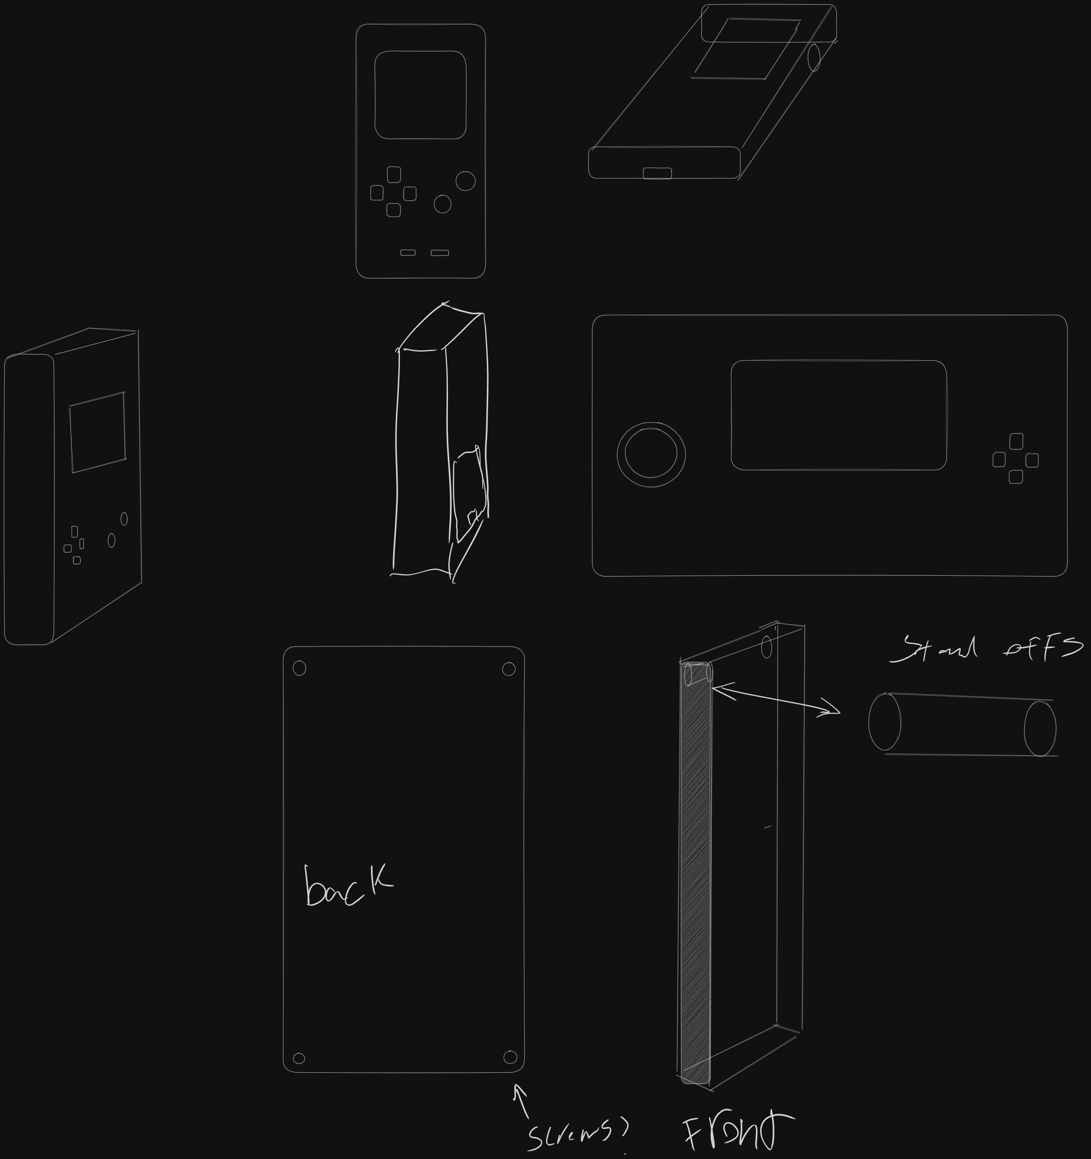
Design

Slide 6
Design

Slide 7
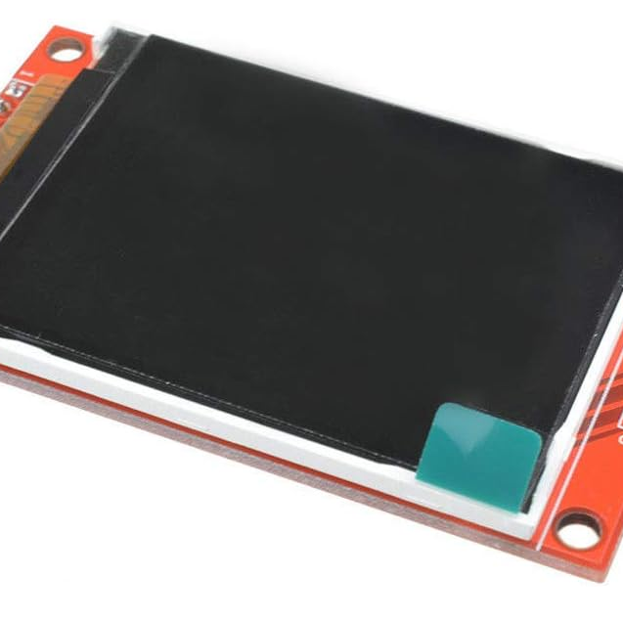
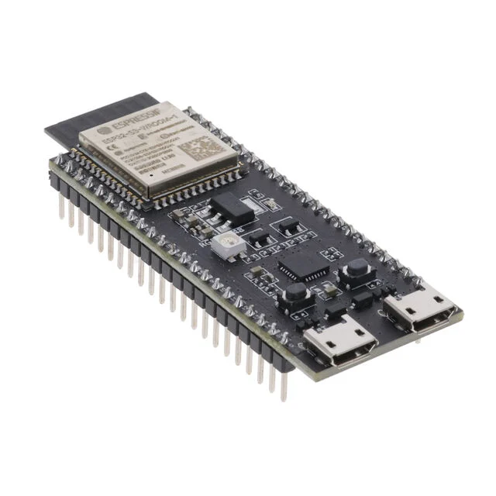
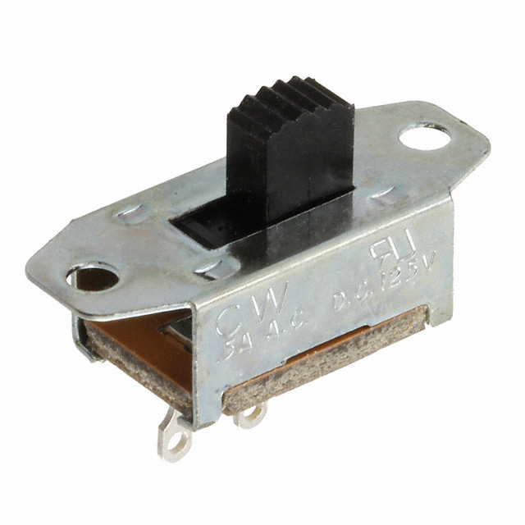
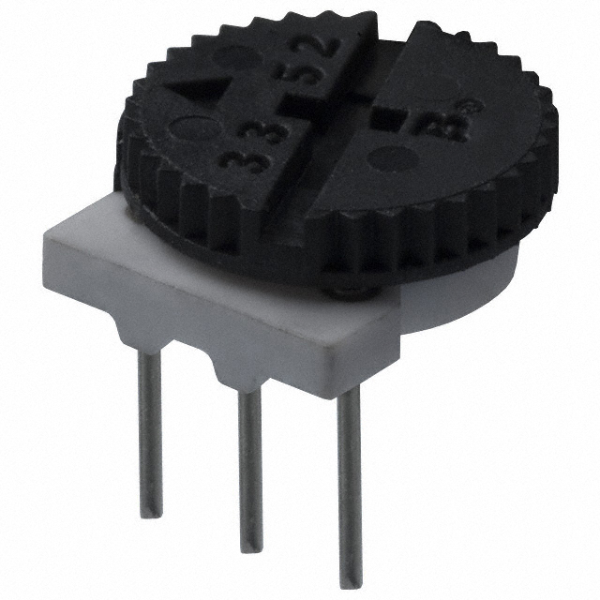
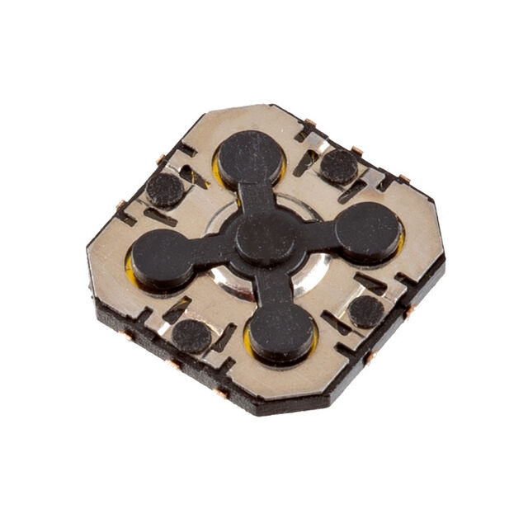
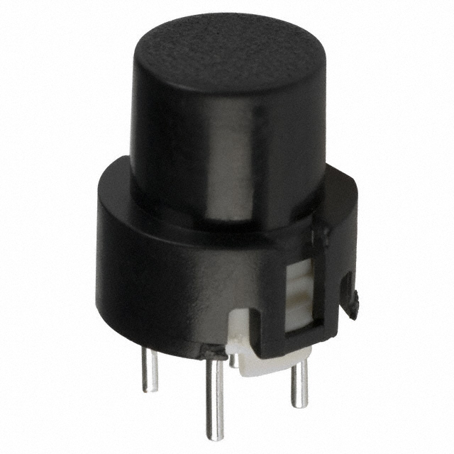
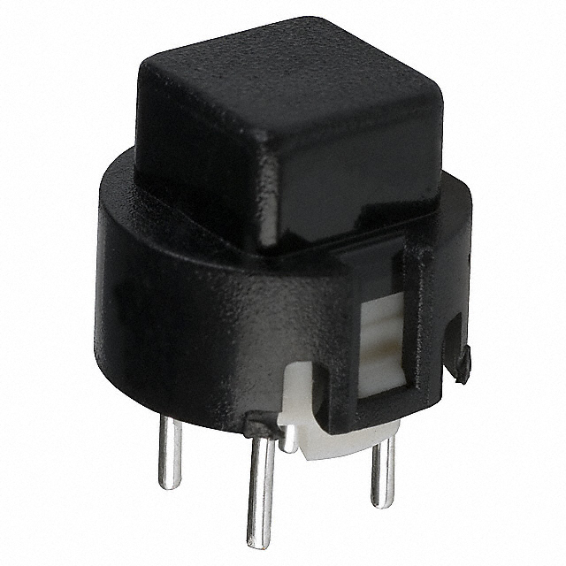
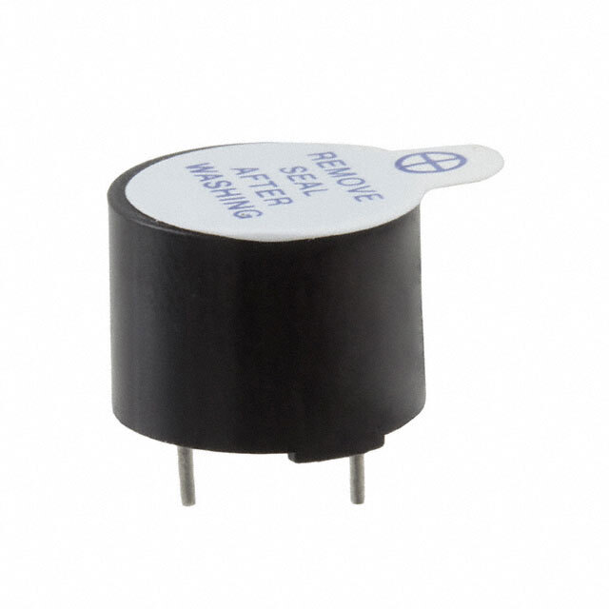
Parts
Display
ESP32
Power Switch
Volume Wheel
D-Pad
A & B Buttons
Home & Select Buttons
Buzzer Speaker

Slide 8
Display
ESP32
Power Switch
Volume Wheel
D-Pad
A & B Buttons
Home & Select Buttons
Buzzer Speaker

Slide 9
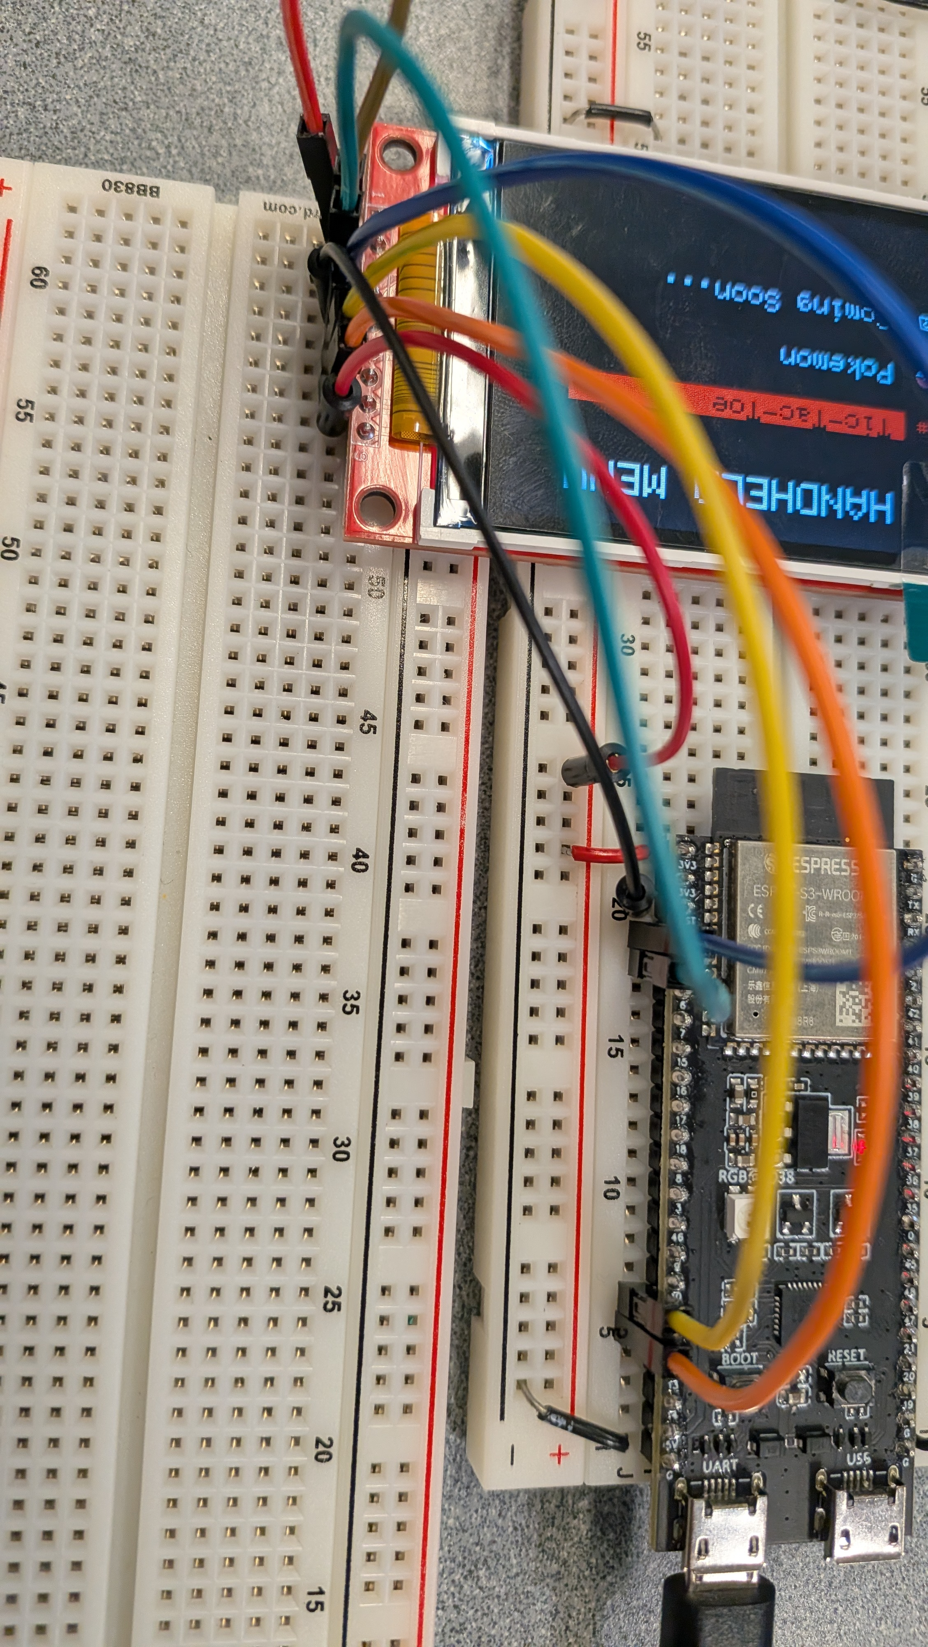
Prototype

Slide 10
Prototype

Slide 11
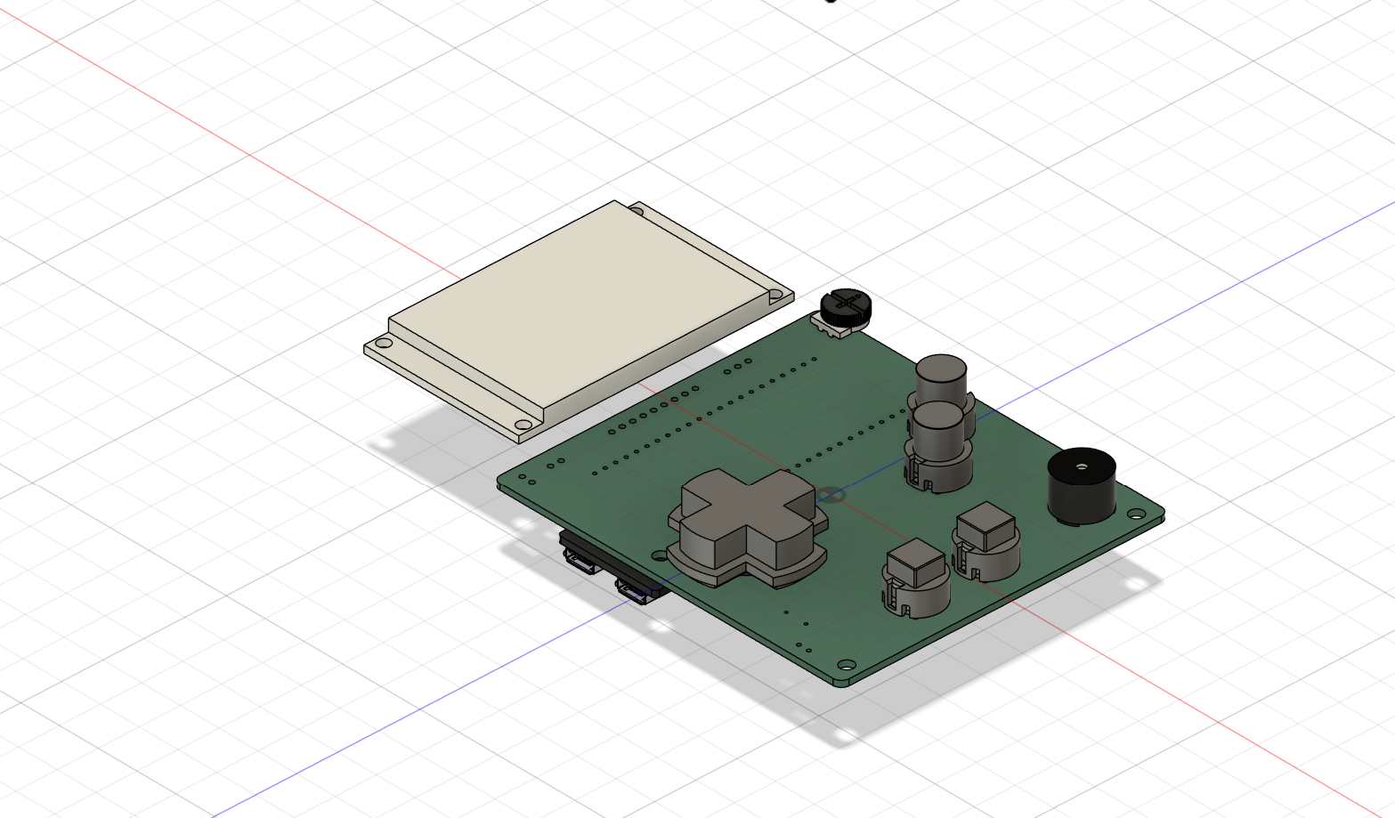
Fusion360

Slide 12
Fusion360

Slide 13
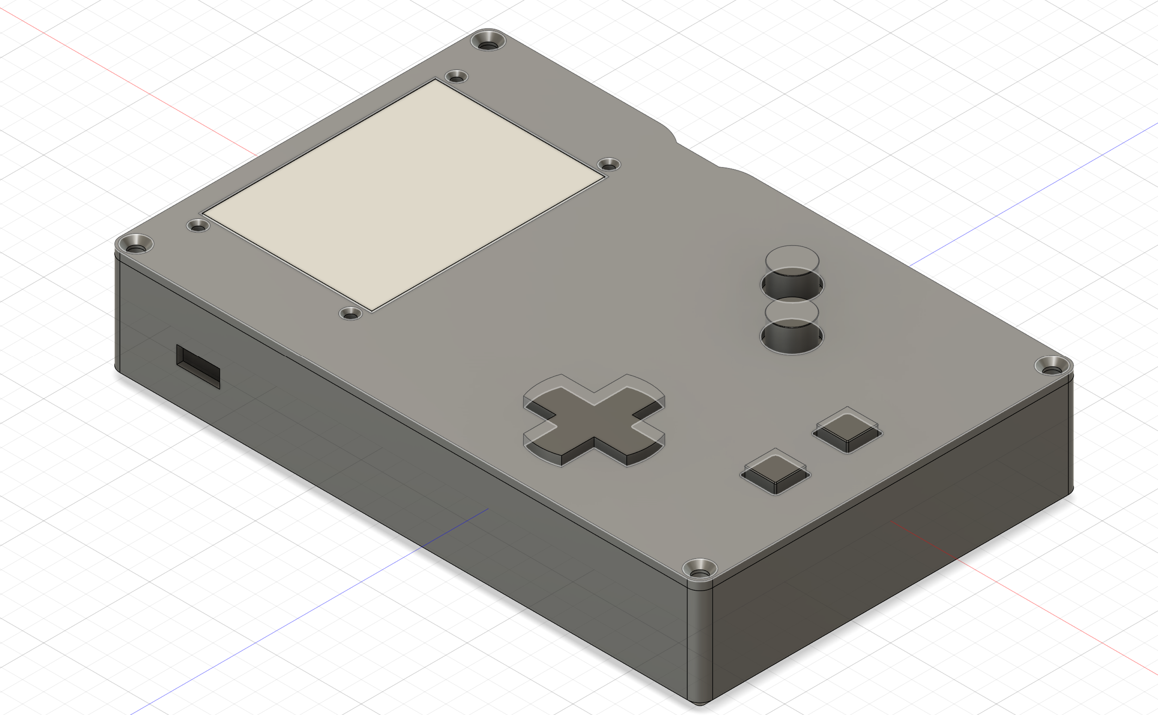
Fusion360

Slide 14
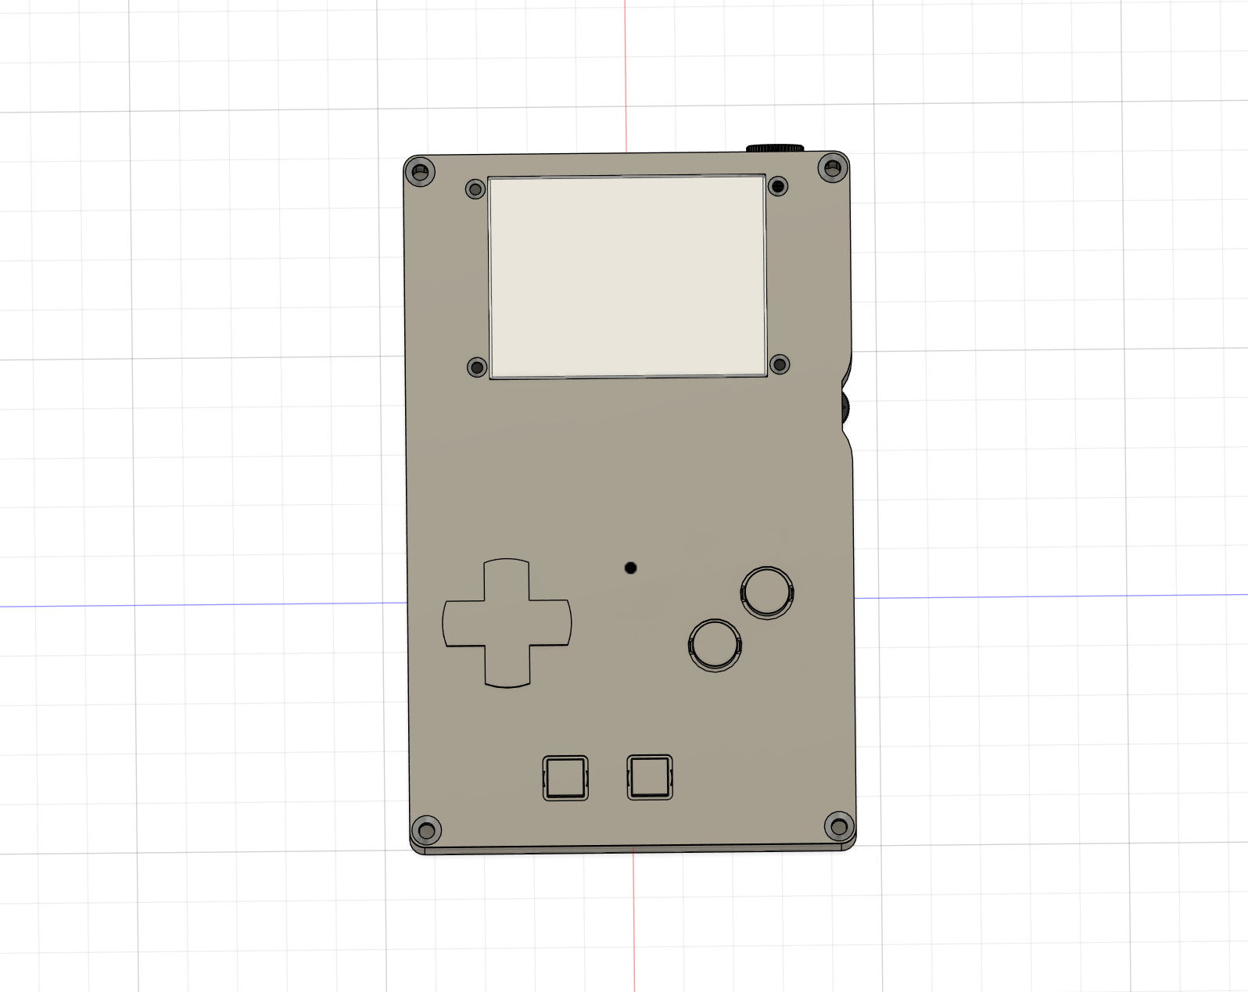
Fusion360

Slide 15
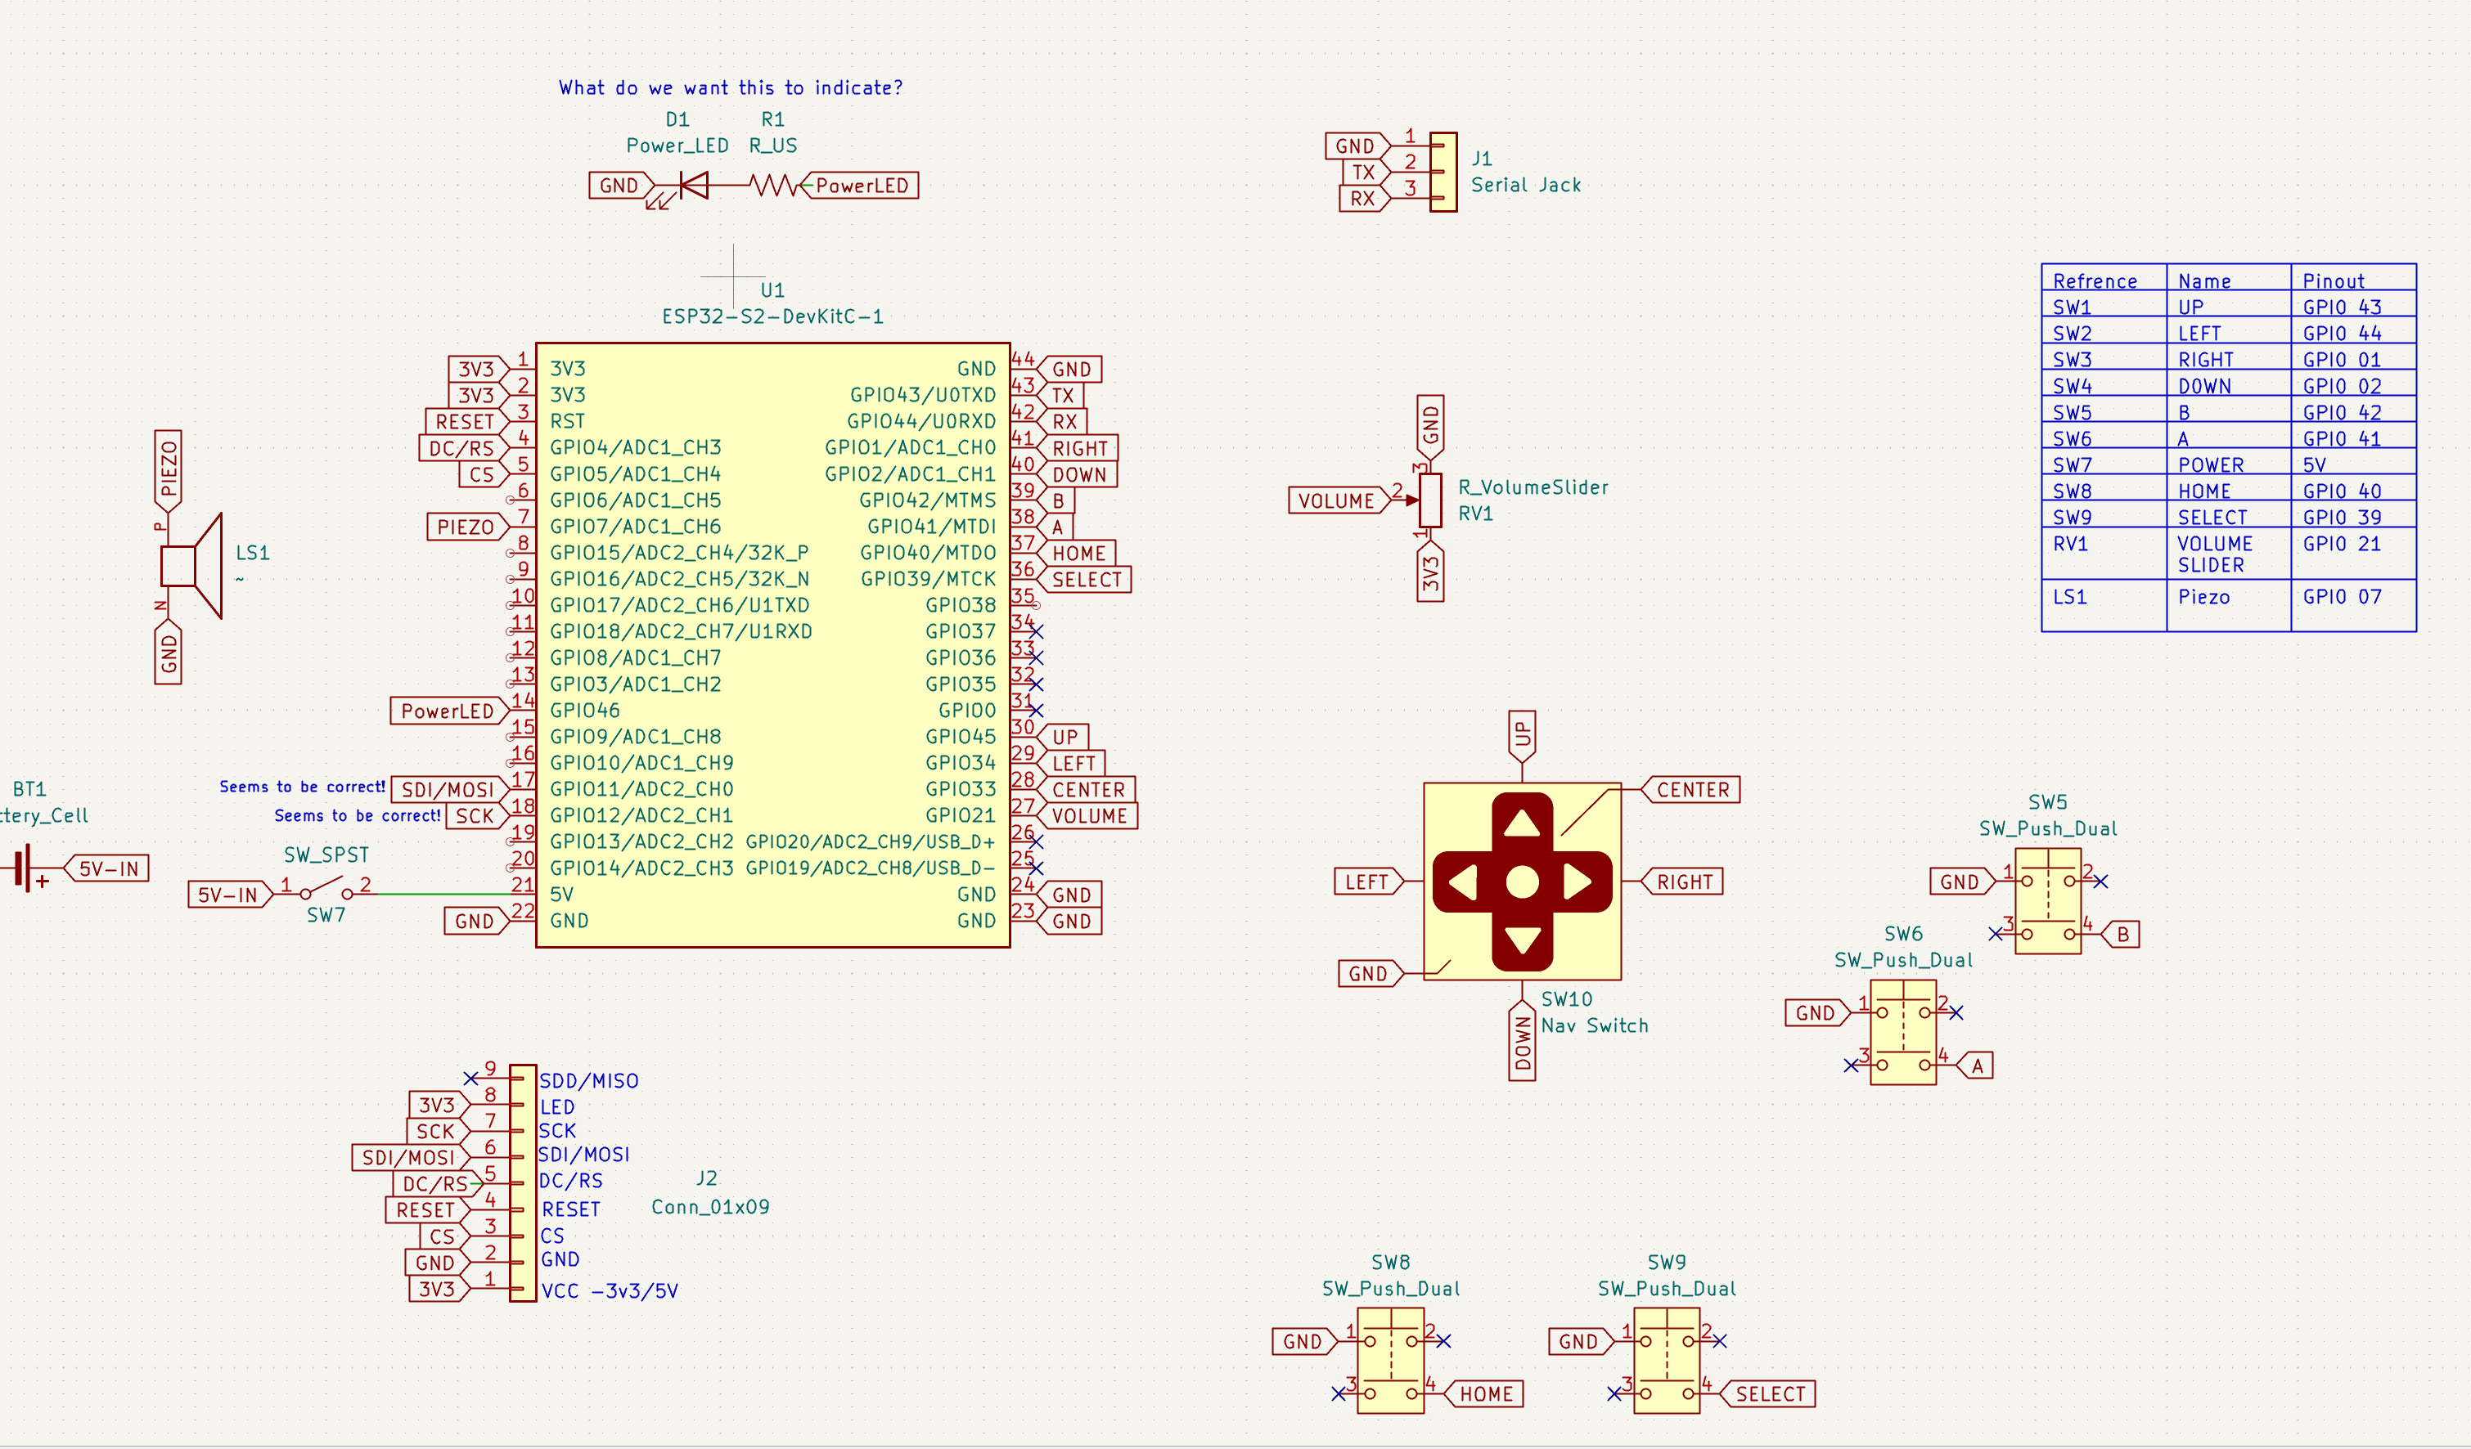
The PCB

Slide 16
The PCB

Slide 17
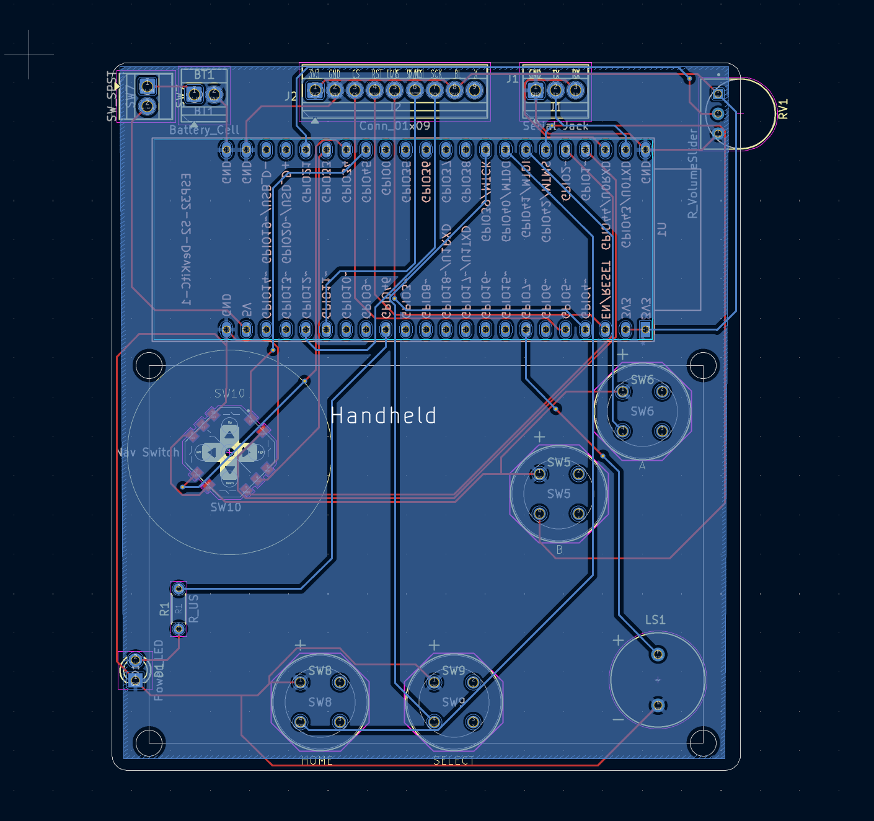
The PCB

Slide 18
Code
It was a lot

Slide 19
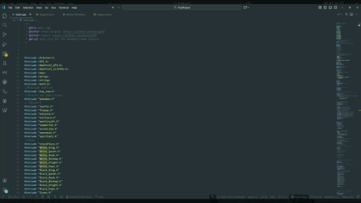
Code
It was a lot
Like 3000+ lines a lot

Slide 20
Code
It was a lot
Like 3000+ lines a lot

Slide 21
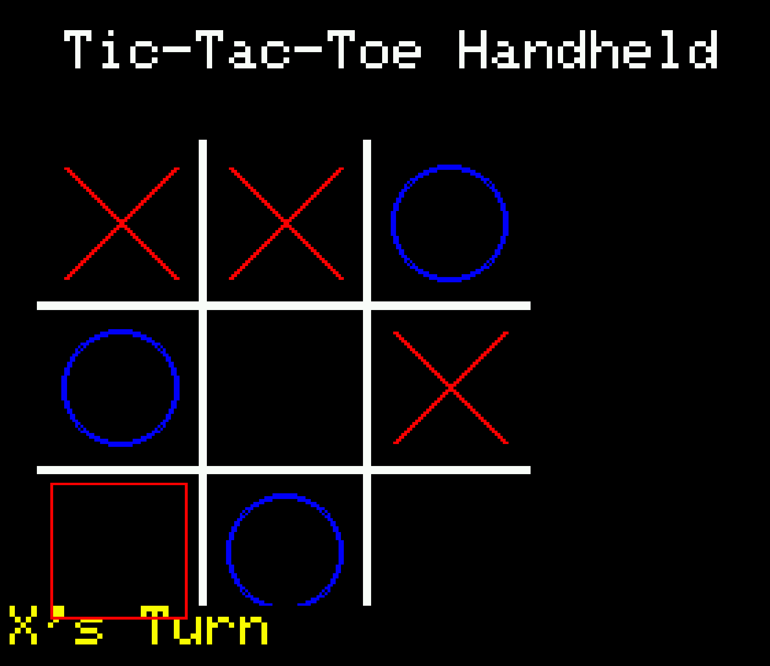
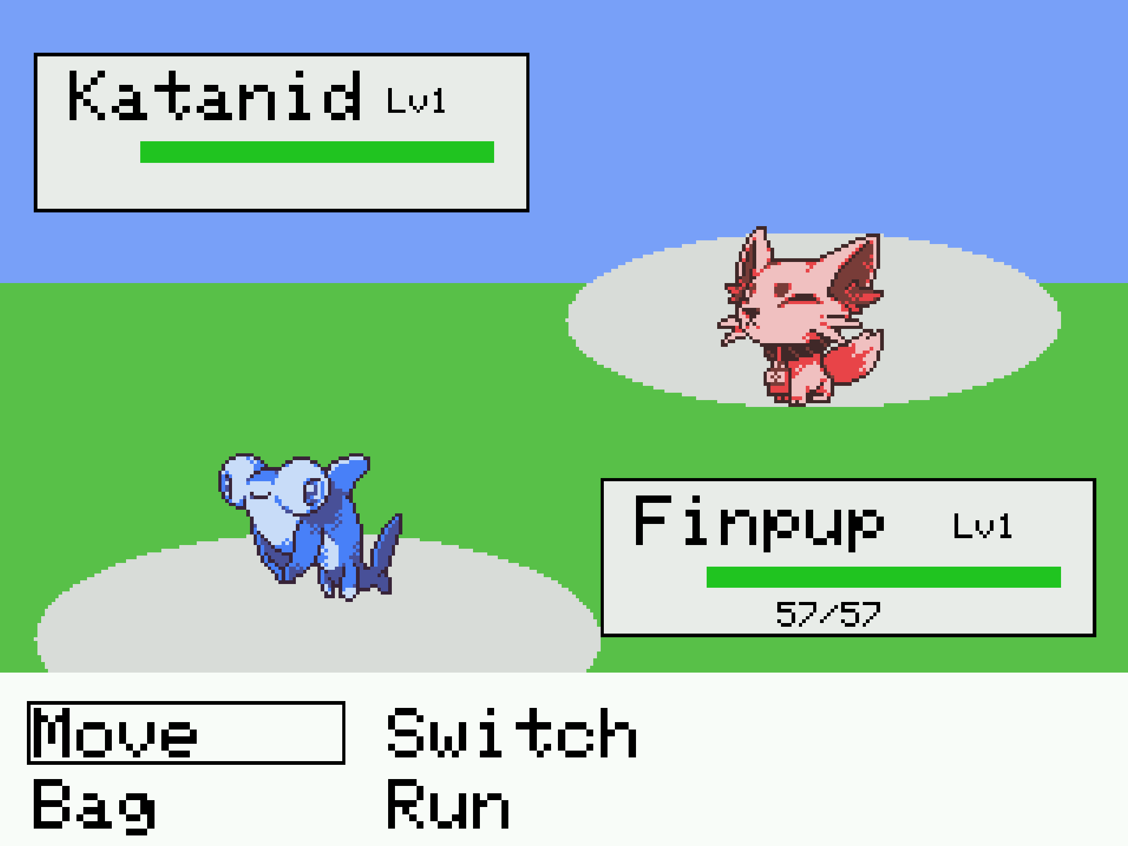
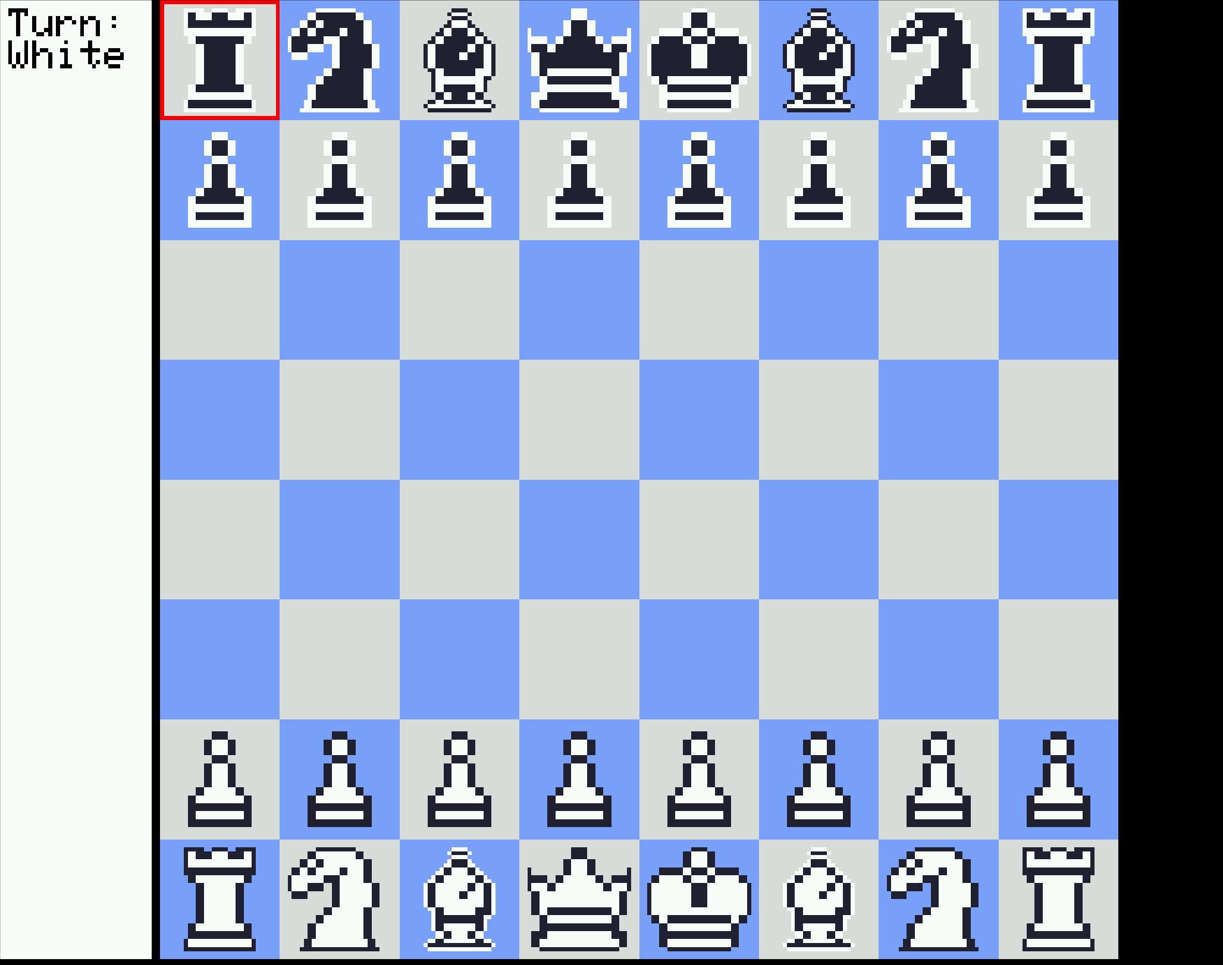
Games

Slide 22
Games
Tic-Tac-Toe
Pokémon Battler
Chess
Pass and play
It’s Tic-Tac-Toe … so yeah
Singleplayer
9 different monsters with unique ability's
Pass and Play
Linked Multiplayer

Slide 23
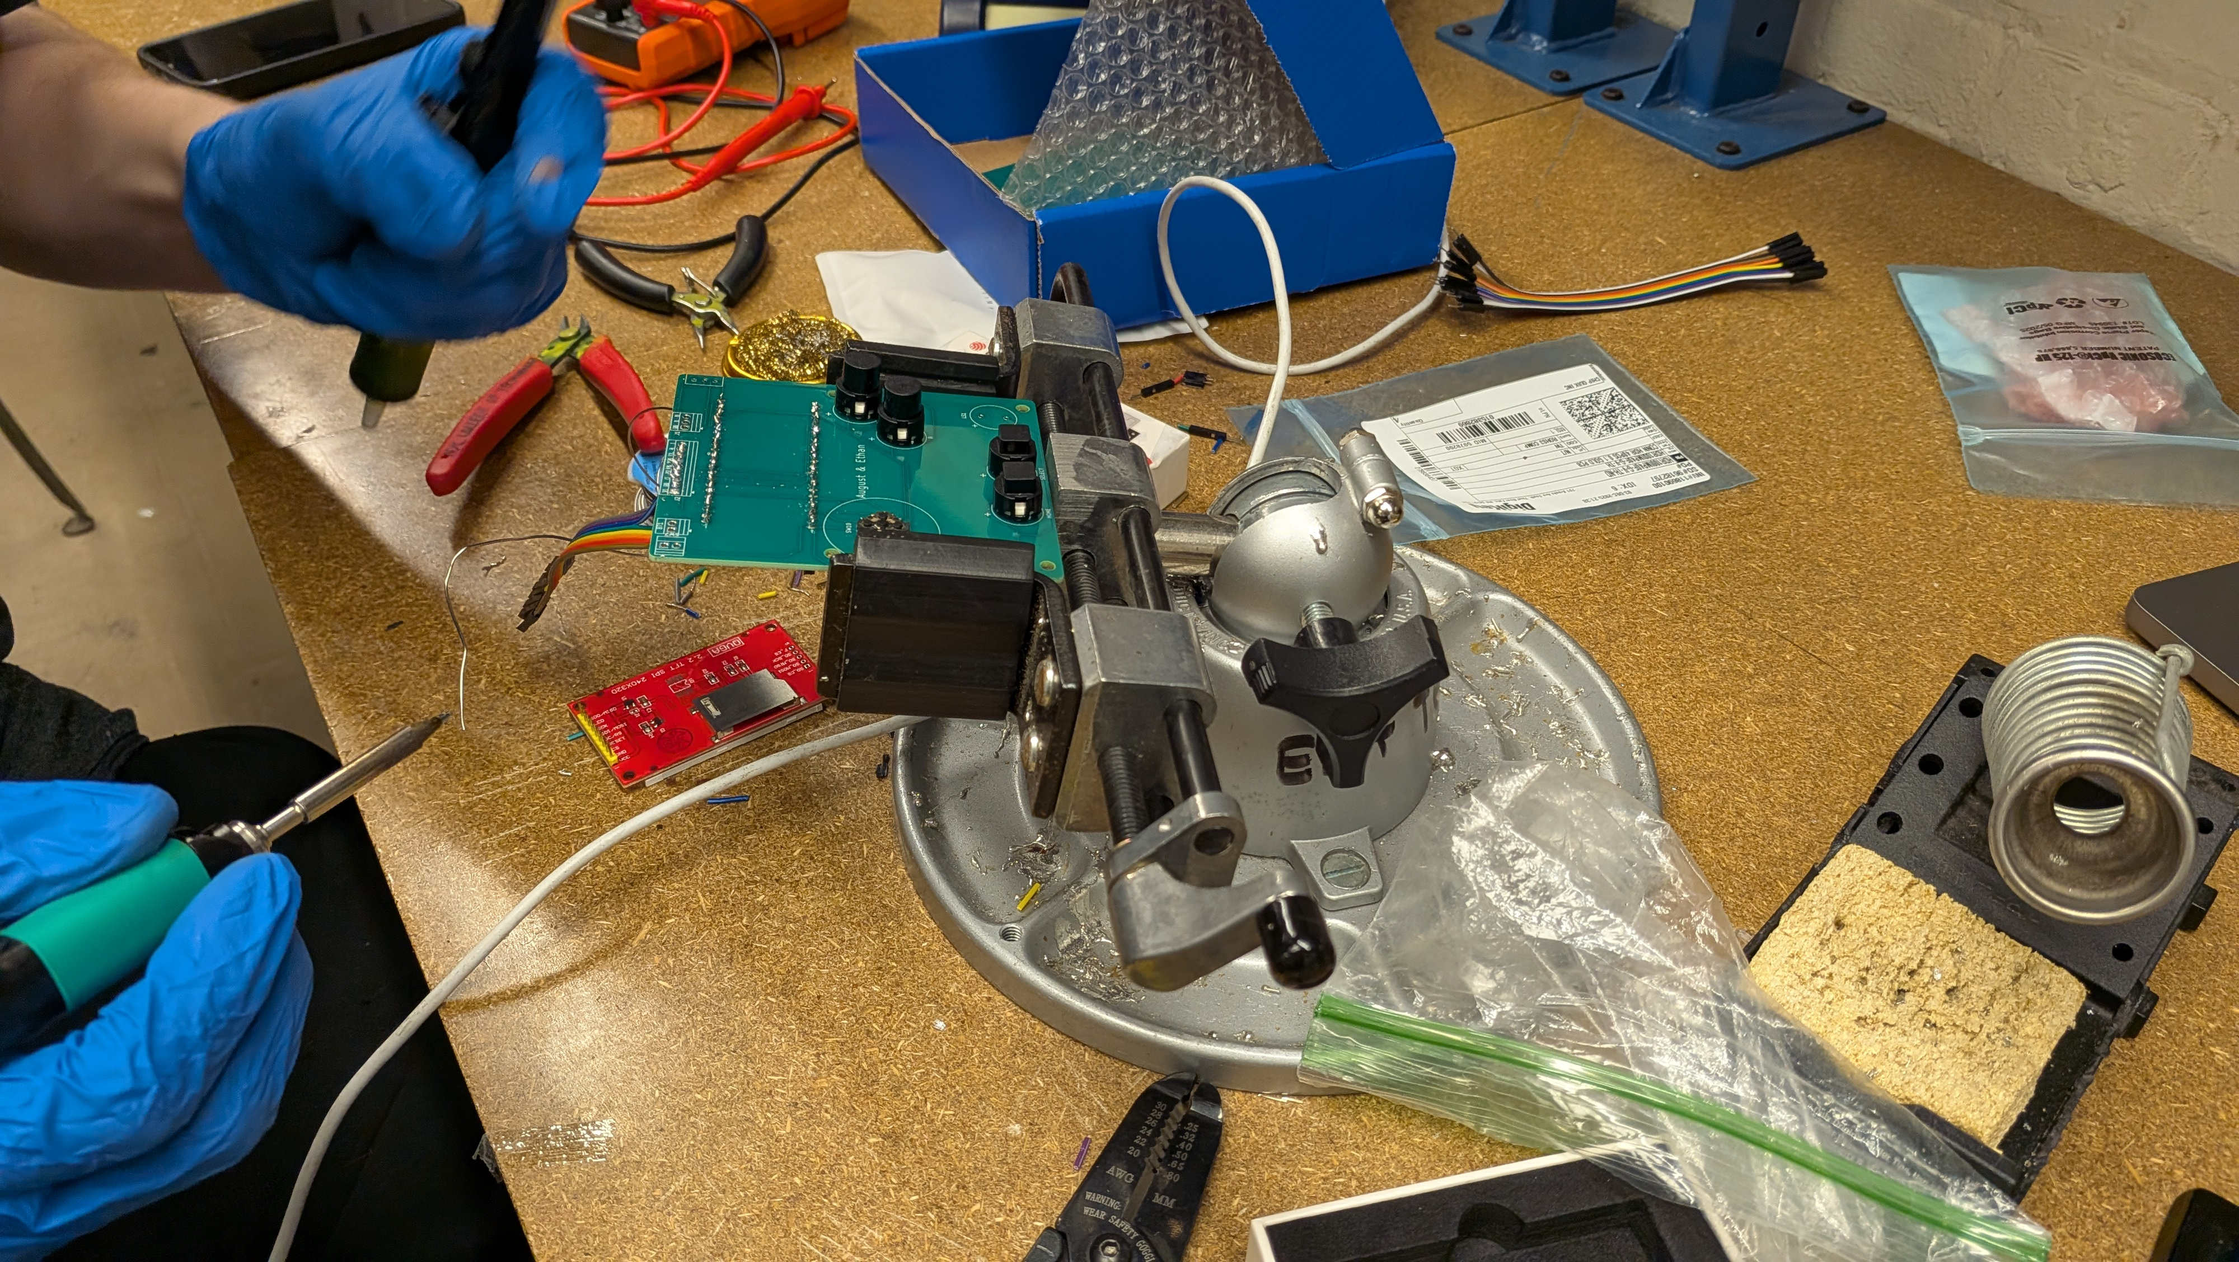
Putting it all together

Slide 24
Putting it all together

Slide 25
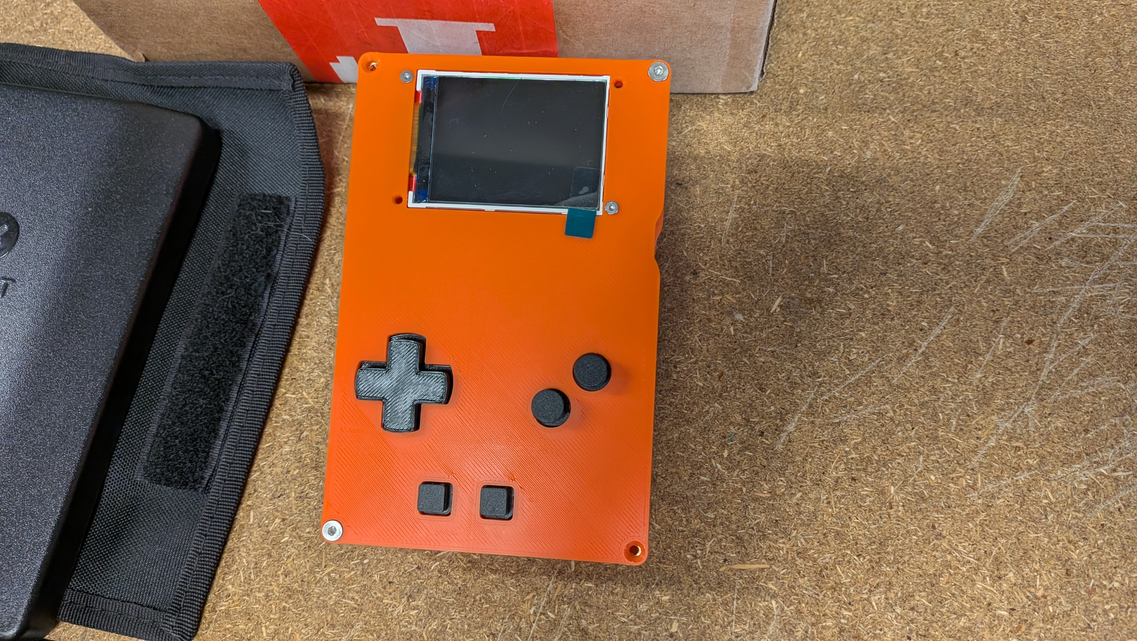
The Final Product

Slide 26
The Final Product

Slide 27
Thank you!

